Slide 1
PBR Rendering
Kirsten Pilla

Slide 2
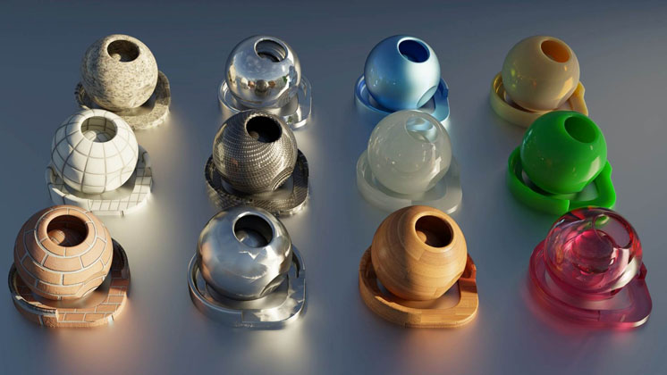


Slide 3
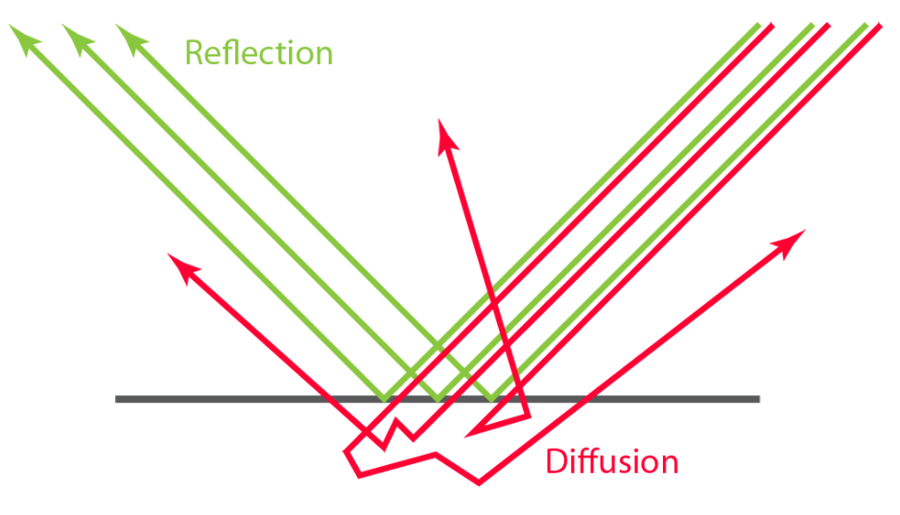
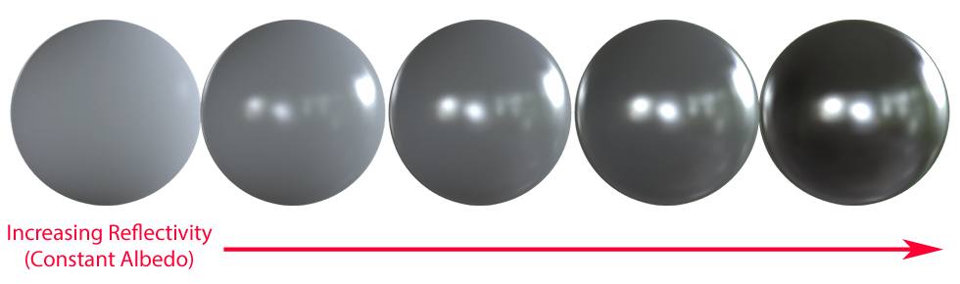
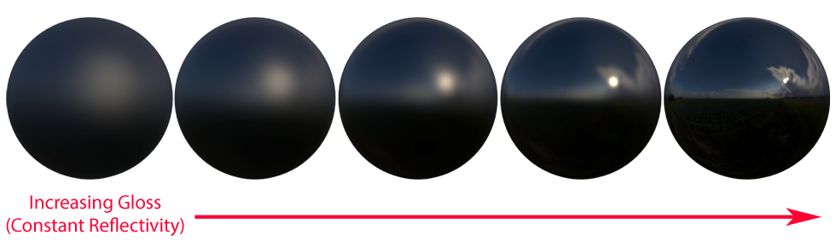
Reflectivity
Diffused light + Reflected light (specular) = Total light hitting the surface
Spread of reflected light depends on roughness/
glossiness

Slide 4
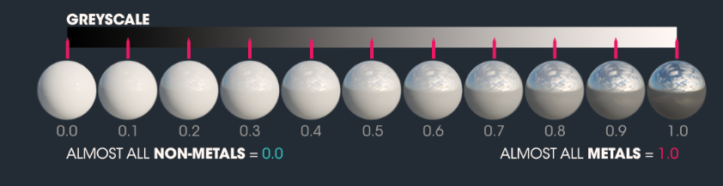
Metalness
Less Reflective
Reflections more white
More Reflective
Reflect same color as diffuse

Slide 5
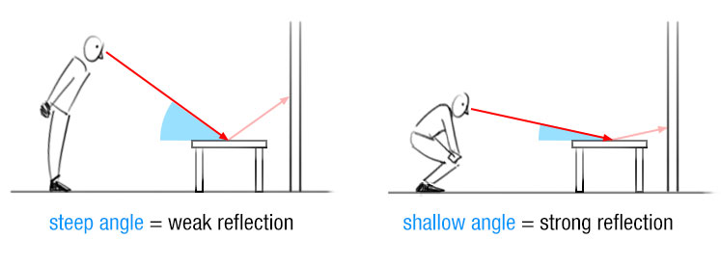
Fresnel Effect
Surface is more reflective depending on angle of incidence

Slide 6
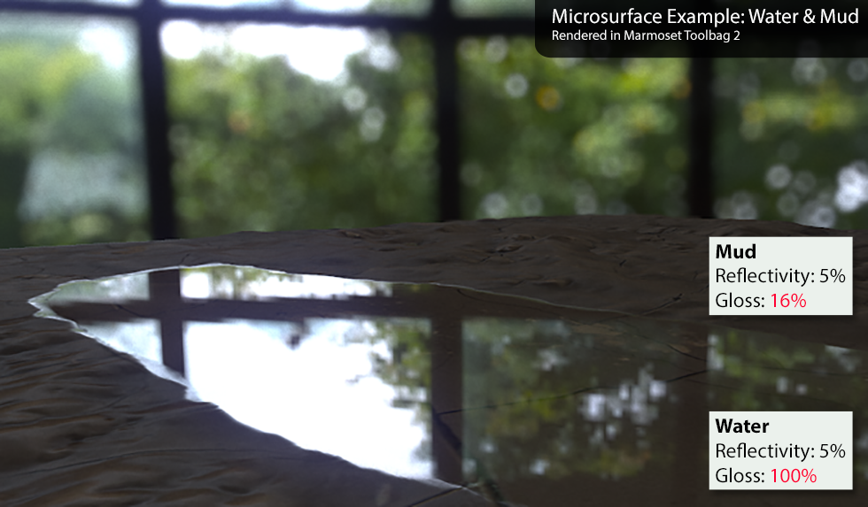
Microsurfaces
Real-world surfaces have minor imperfections, which affects diffusion and reflection of light
Brighter edges!

Slide 7
Sources
https://www.digitalengineering247.com/article/material-matters-in-rendering/
https://marmoset.co/posts/basic-theory-of-physically-based-rendering/
https://blogs.unity3d.com/2015/02/18/working-with-physically-based-shading-a-practical-approach/
https://www.dorian-iten.com/fresnel/

